Slide 1
Expository Writing: Cross-Cultural Encounters in the Middle Ages
Instructor:
Nathan Daniels
Please take a syllabus and fill out a questionnaire (by the door)
– I’ll collect them at the end of class.

Slide 2
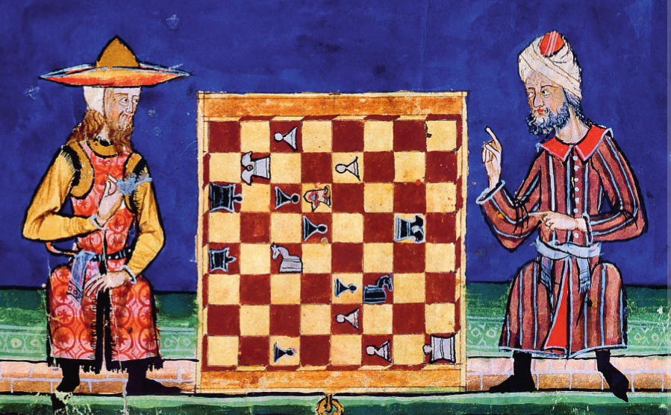
Chess in al-Andalus
Alphonso X of Castile, El Libro De Los Juegos (13th c.)
Spain, Real Biblioteca de San Lorenzo de El Escorial, fol. 63r

Slide 3
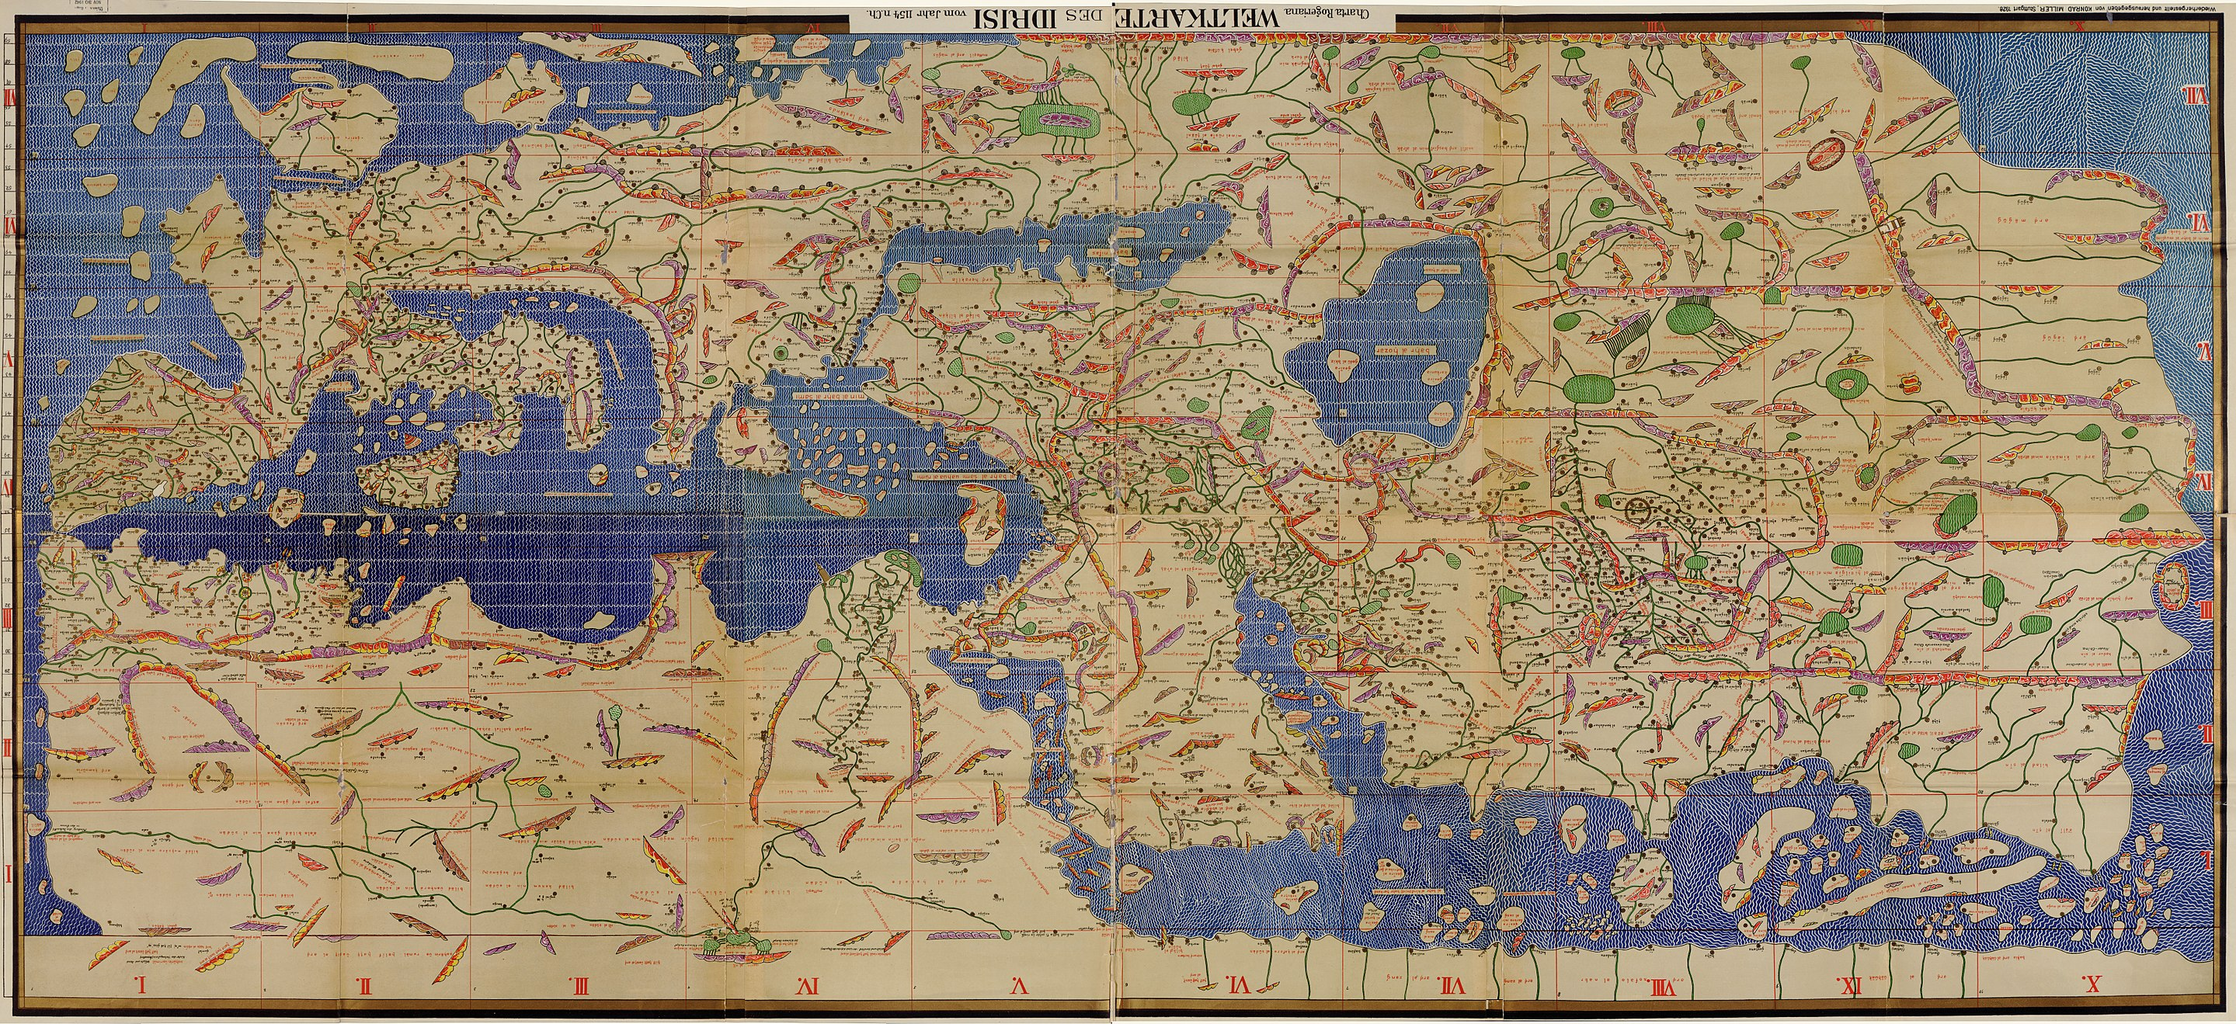
al-Idrisi, Tabula Rogeriana (1154)

Slide 4
al-Idrisi, Tabula Rogeriana (1154)

Slide 5
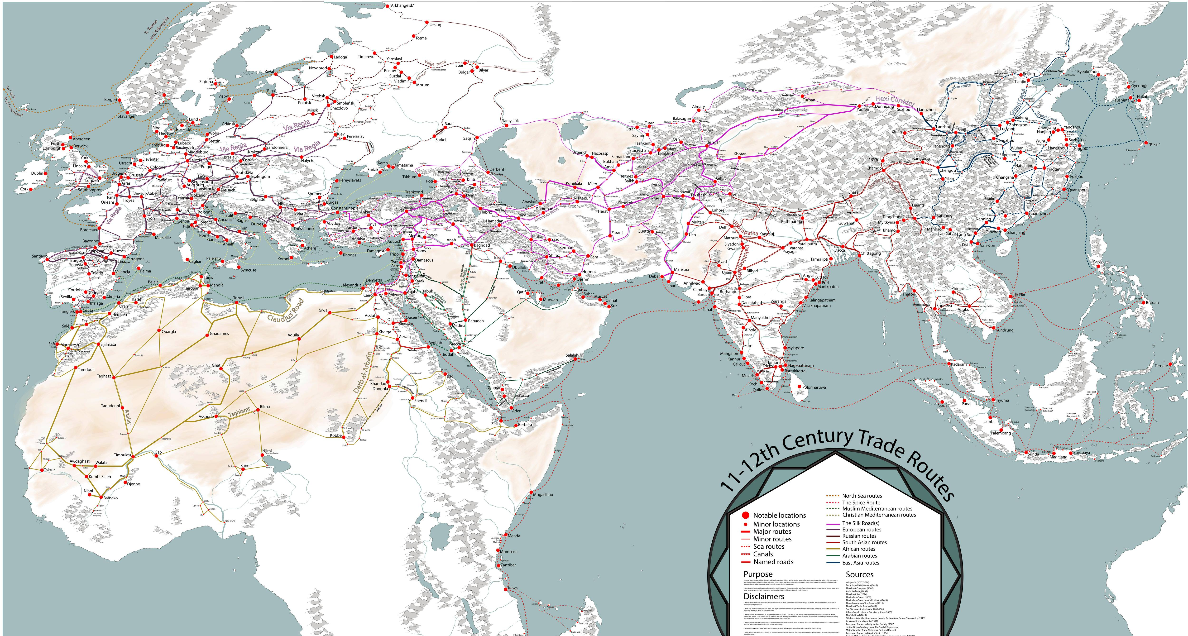
Medieval Trade Routes

Slide 6
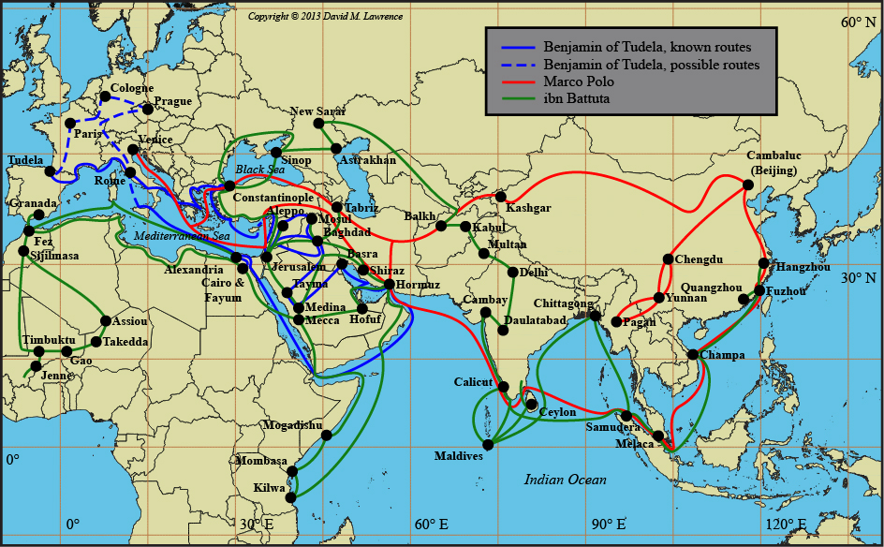
Medieval Travelers

Slide 7
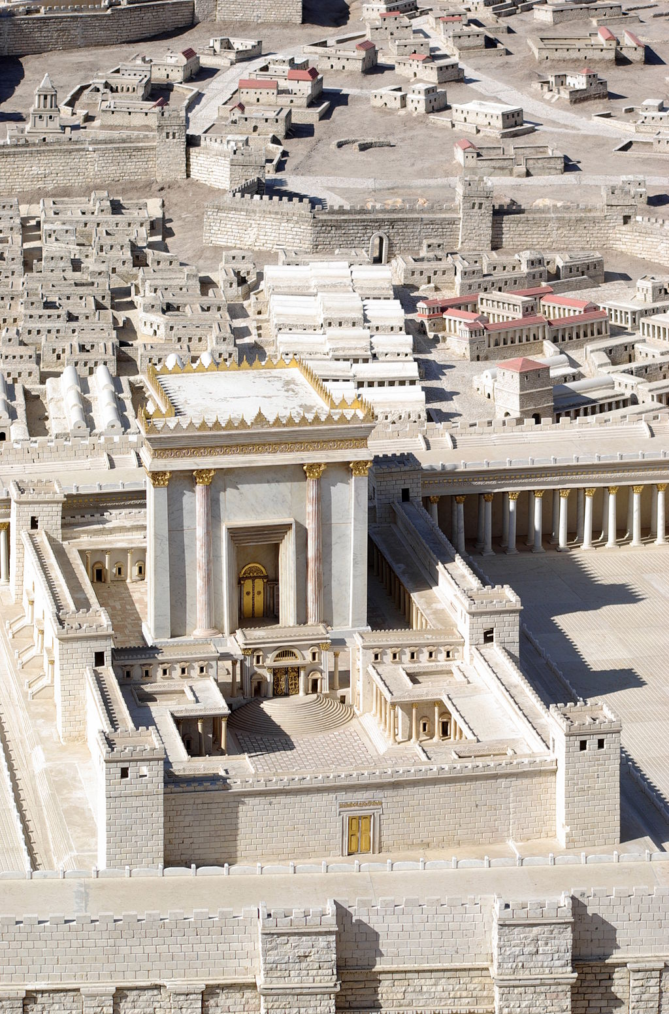
Second Temple
Jerusalem
537 BCE – 70 CE
Model, after Josephus
Israel Museum

Slide 8
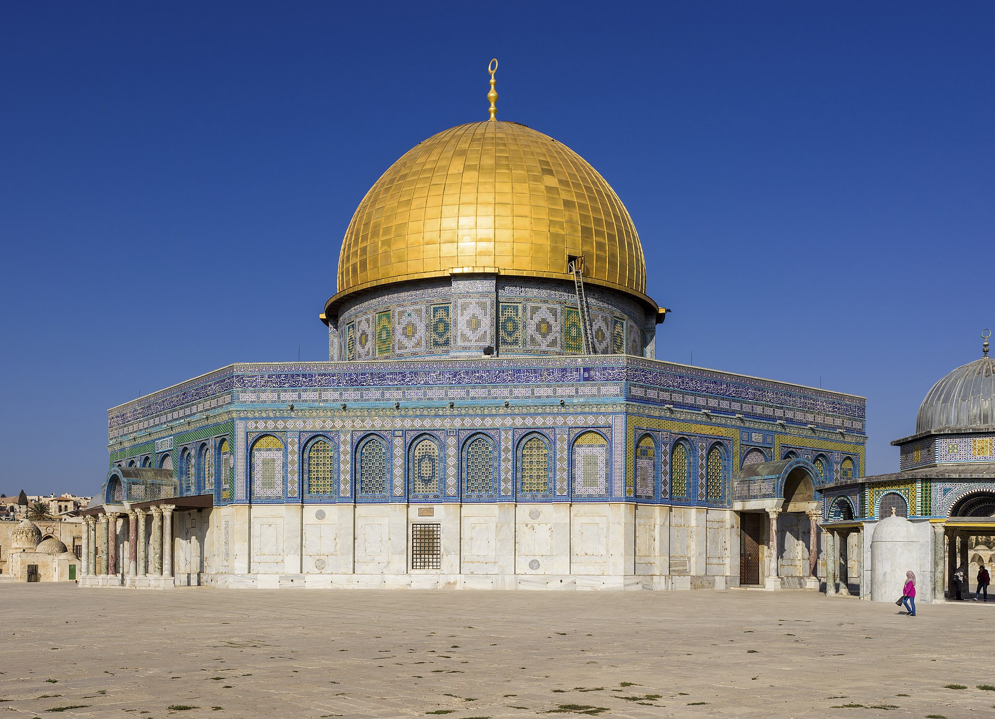
Dome of the Rock (688 CE)

Slide 9
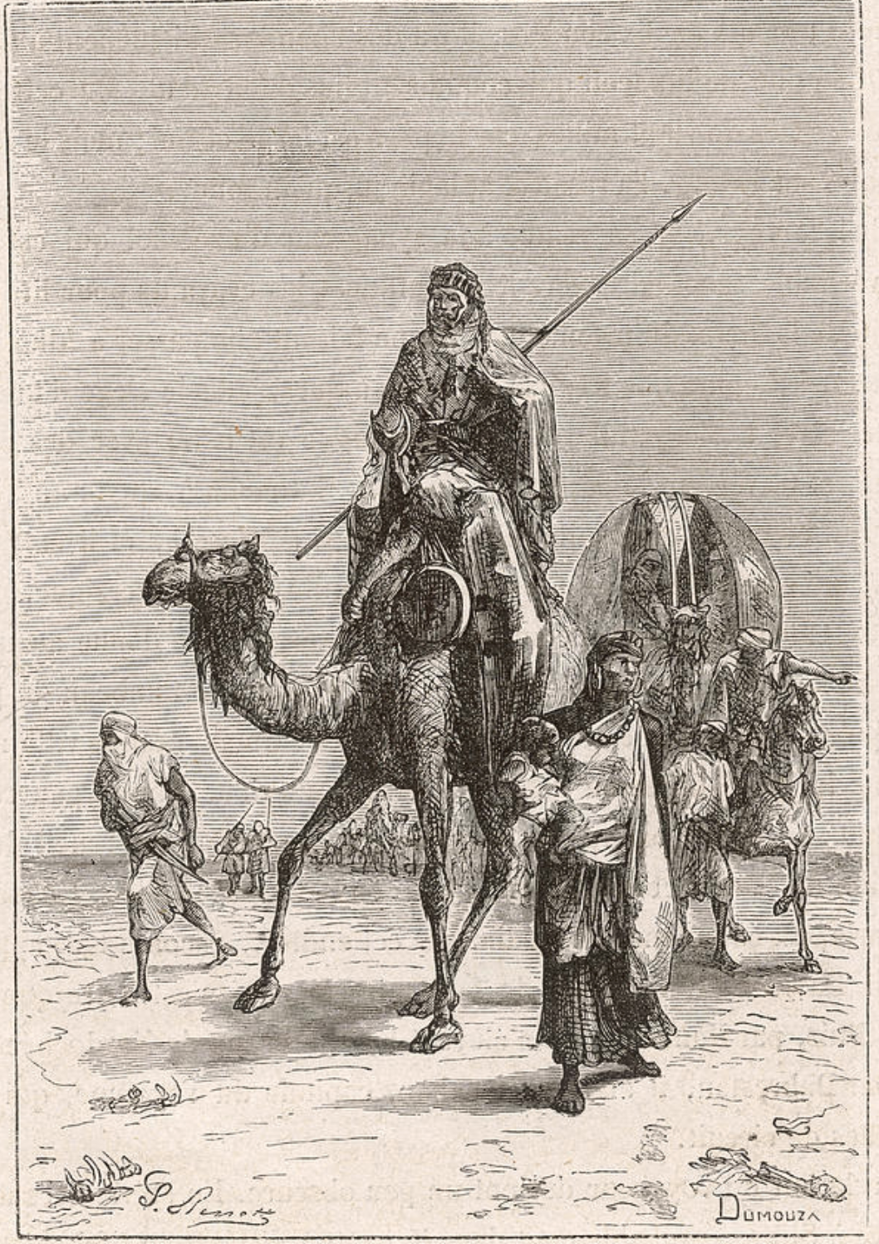
Benjamin of Tudela
(fl. 12th century)
Dumouza (19th c.)
Engraving

Slide 10
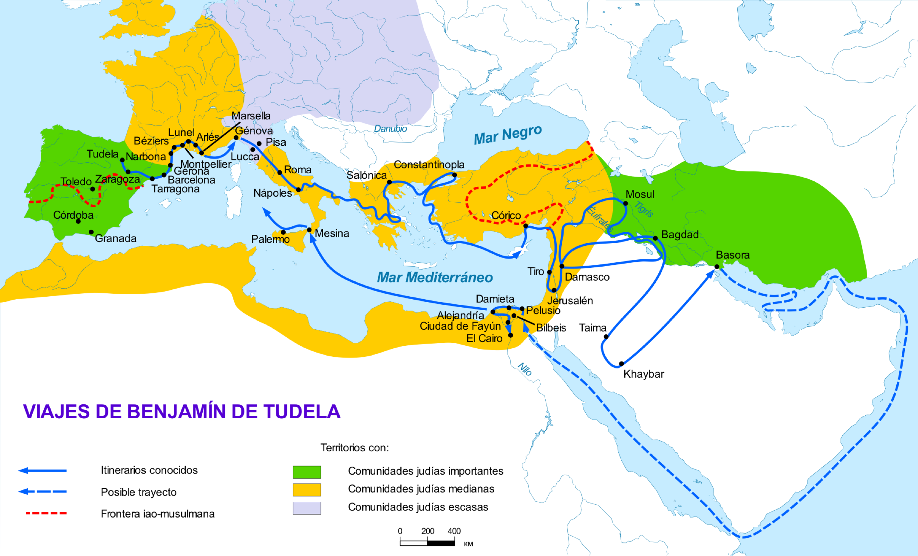
Itinerary of Benjamin of Tudela

Slide 11
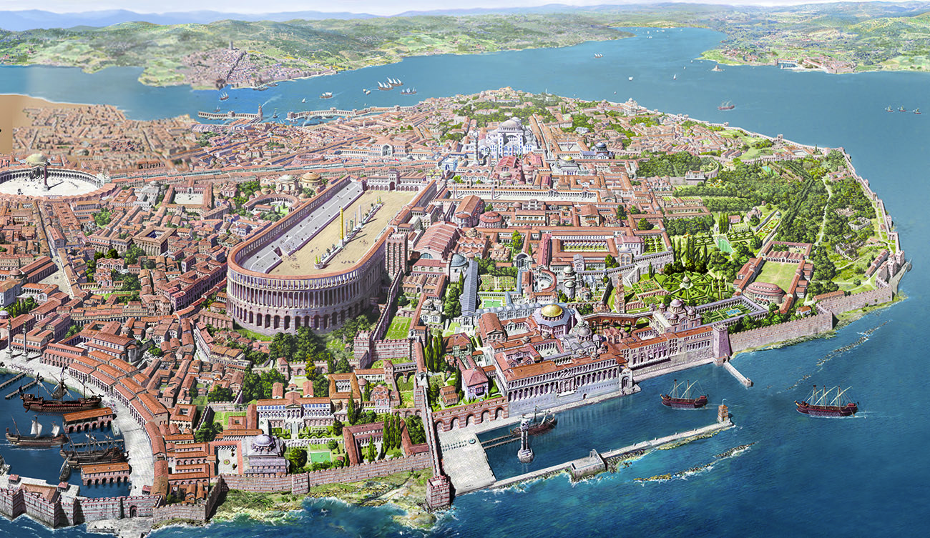
Constantinople

